Slide 1


Presenters:
-Lucian Corlan
-Security Champion

Slide 2
About Me
Lucian Corlan
Currently AppSec @Sage
Currently Supporter of OWASP London Chapter
Ex-AppSec @Betfair
Ex-Chapter Leader @Cluj-Napoca Romania
Working in Security since 2006
Security Champion!

Slide 3

Context
40+ Security Team
170+ Security Champions
(as of March 2020)
200+ Products
50+ IT Services
8 regions
15+ countries with Tech
24 total countries
3500+ Technology personnel

Slide 4
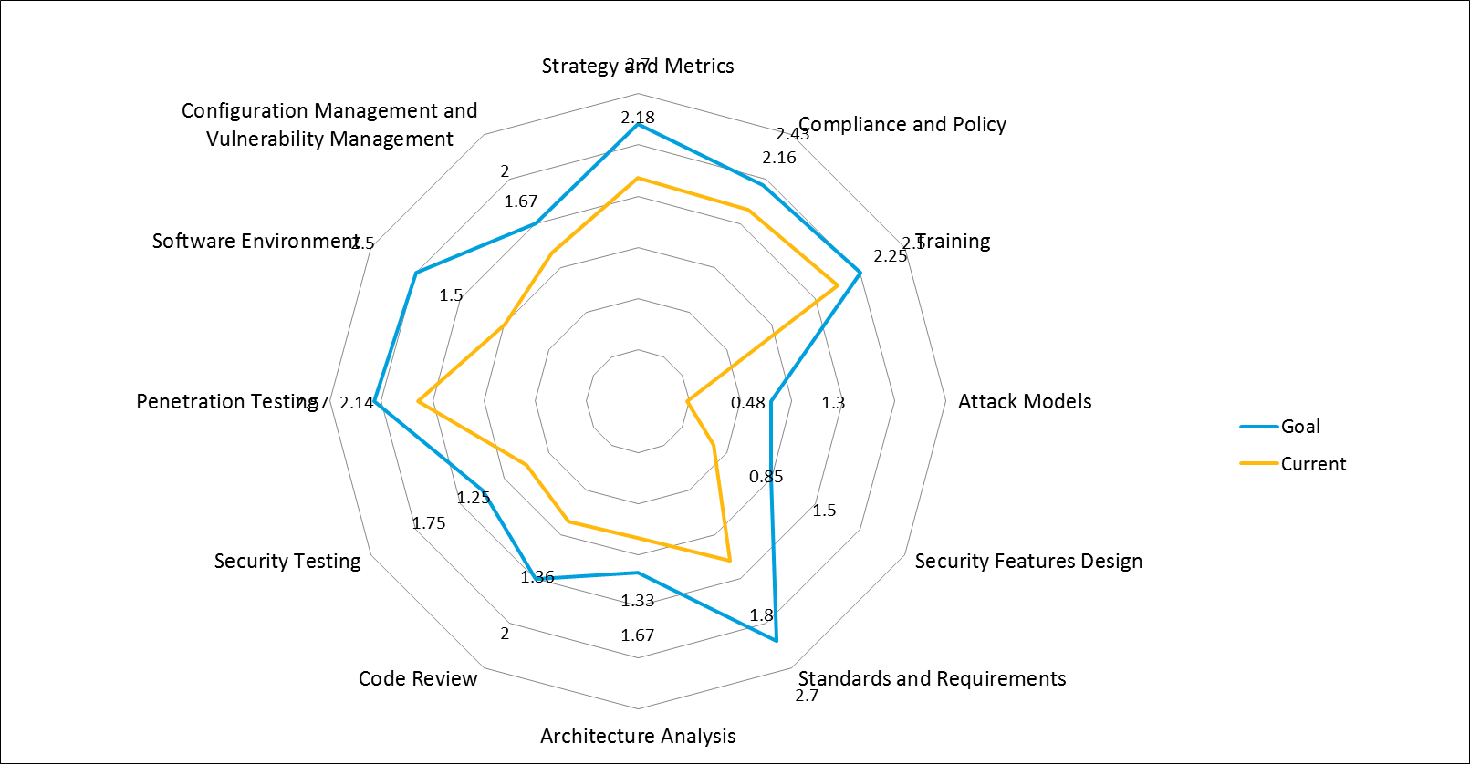
Why Security Champions? Application Security Initiative maturity
Application Security maturity is assessed as part of a drive to increase development teams’ awareness and use of security within the SDLC. In this respect, OWASP OpenSAMM and BSIMM are used for continuous Application Security Initiative Maturity improvement.
The Security Champions are a key element of the model.
Security Satellites a.k.a. Champions

Slide 5
What is currently available
OWASP Security Champions Playbook HERE
OpenSAMM v2 (yay!)
BSIMM v10
SAFECode guide (2019) HERE
[…?]

Slide 6
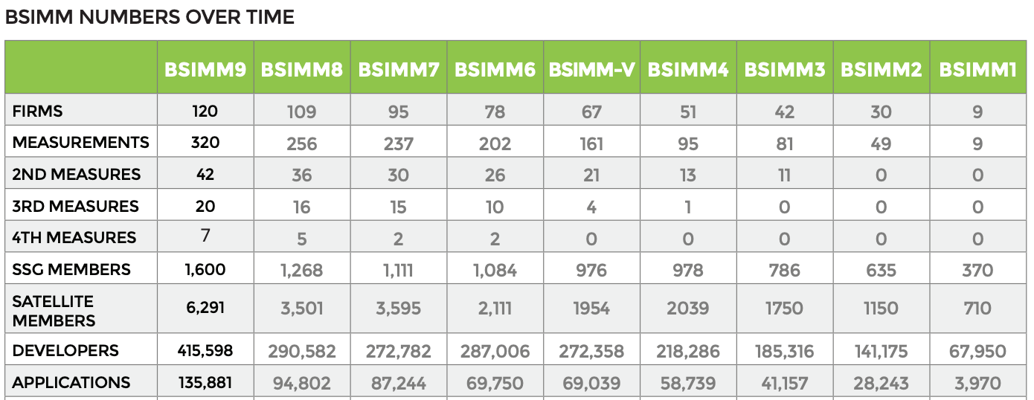
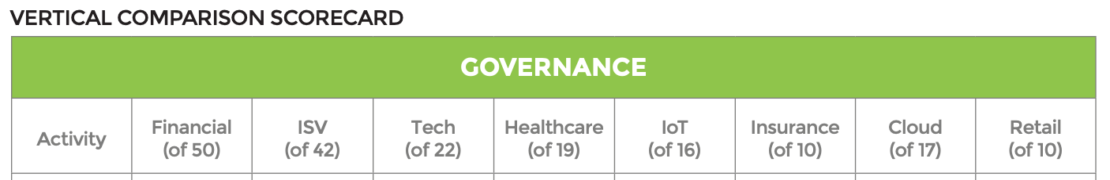
What is being done?
Using the Building Security In Maturity Model v9 – security champions a.k.a. Satellite Members – Sage Business Cloud maturity on a further slide.
36.7% of participant businesses have implemented the Security Champions initiative, that is 44 out of 120 firms.
Numbers for 120 firms such as NetSuite, CapitalOne, PayPal, Fidelity, Sony and others.
How many businesses employ security champions per sector.

Slide 7
GOALS for Champions
GOAL for Security Champions
Support the Global Security Team in all matters related to security in your assigned area – indicative % is 10% of my time

Slide 8









What do Security Champions do?
Business As usual
Building Security
Security Processes
Security Tools
Vulnerability Tracking
Take security responsibility into Business As Usual work and raise to product security team when uncertain
Participate / deliver Building Security In Maturity Model assessments / gap analysis for your area of responsibility
Learn, follow and/or adapt security process – such as Security Controls evaluation, Threat Modelling and Security Definition of Done
Learn and work with security tools/reports – static code analysis, dynamic, dependency checking, automation
Vulnerability tracking - be responsible for tracking vulnerabilities in their area and ensure they are addressed in time
Champions Meetups
Trainings & Certifications
Sage Security Portal
Collaboration
Volunteering
Attend security champions meetups for products security status and knowledge sharing
Follow security training and secure one course and/or certification
Contribute to Sage Security Portal and to existing or new security documentation
Collaborate as a local and global security champion group
Participate in applicable volunteering opportunities for security champions (e.g. Digital Defenders/STEM outreach programs etc.)

Slide 9






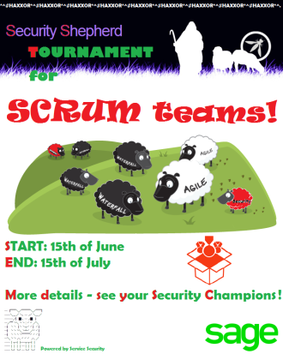


TRAINING

Slide 10
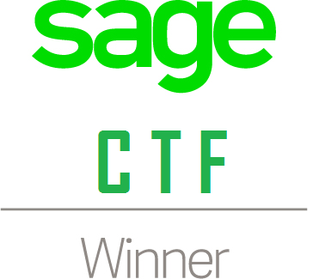
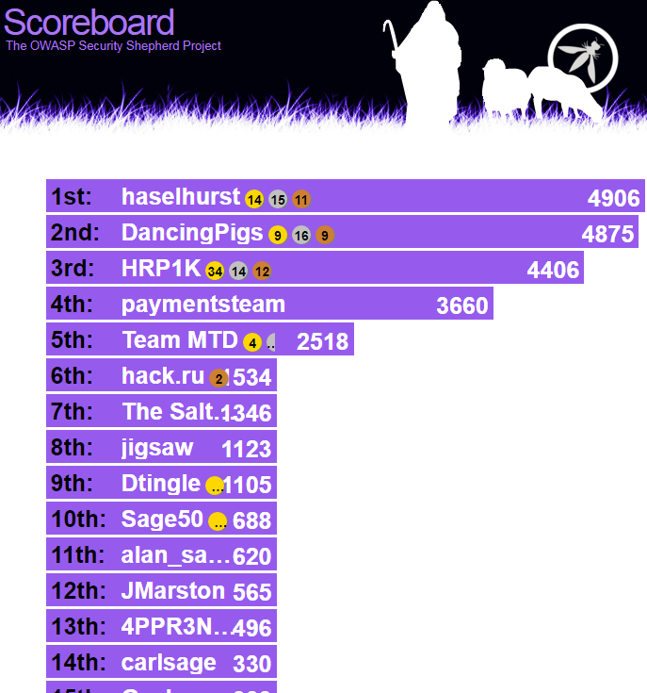
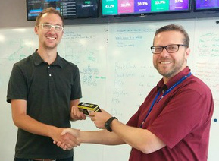
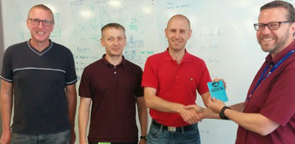
CTFs
27 teams!
1 month long event!
More than 150 people involved
Scope: UK and Ireland

Slide 11
Introducing…

Slide 12
Use of tools (Maturity levels: 1, 2, 3)
Bounty (M123)
Training (M123)
Events (M123)
Security ops (M123)
Sec Reviews / Assessments (M123)
Research (M123)
Development for security (M123)
Reporting (M123)
Threat Modelling (M123)
Detail HERE
How to award?
Maturity one – 1 point
M two – 2 points
M three – 3 points
How to recognise?
Black belt – 15 points with 3 Maturity 3s mandatory
Green belt – 10 points with 2 M2s and 1 M3
White belt – 5 points

Slide 13
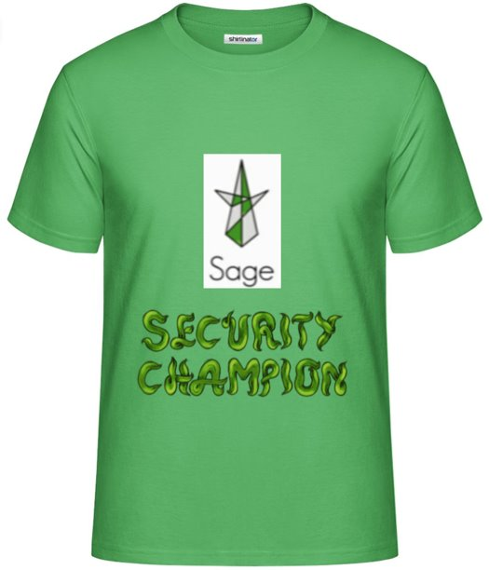



Recognition / Prizes / Swag

Slide 14
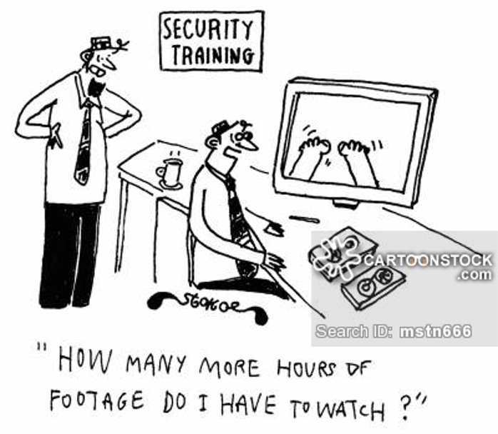
Questions?

